Slide 1

Wireframe
and
Navigation Diagram
Team Azure
Sangam, Damien, Yohanna

Slide 2
Stock Pilot
Dashboard
Low Stock Alert
Total Stock Value
Today’s Sale
Order’s to Restock
Sales Overview
Inventory Status
Starting Page/Home Page
Enter Password
Navigation
Navigation
Navigation
Inventory
Total Items
Low Stock Alert
Out of stock
Order’s to Deliver
Inventory usages
Items to Restock
Sales
Total Revenue
Total orders
Top Selling Item
Ave. Order Value
Sales Chart
Top Products
Order History
Order date
Items Ordered
Quantity
Price
Delivery status
Navigation
Navigation
Navigation

Slide 3




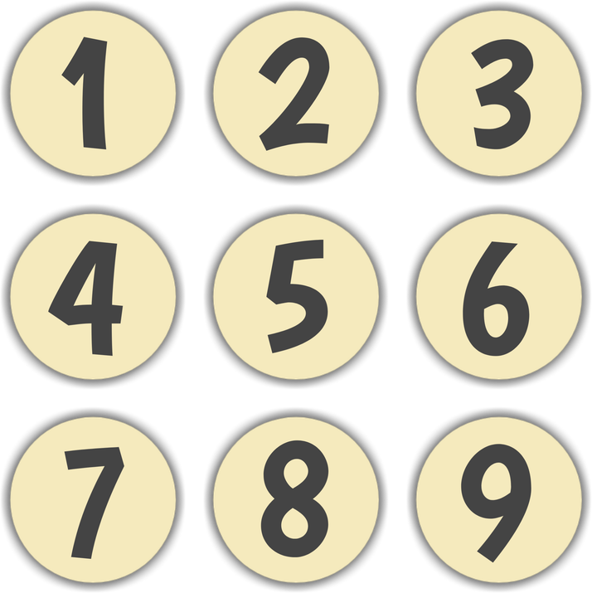






Hello David!!
Enter Password
|

Slide 4


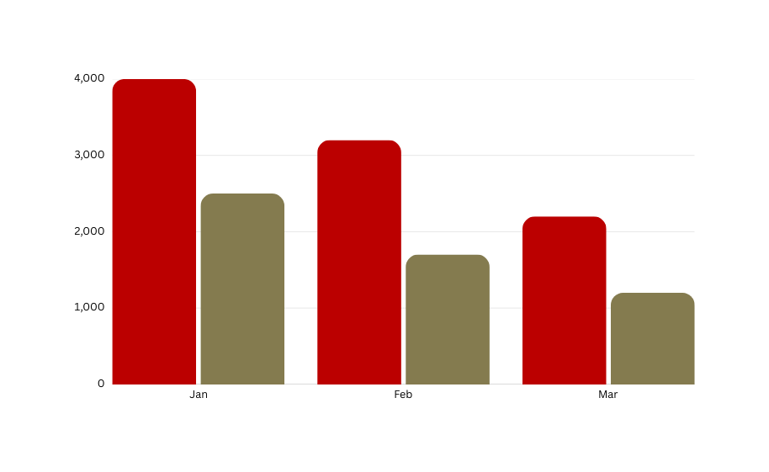

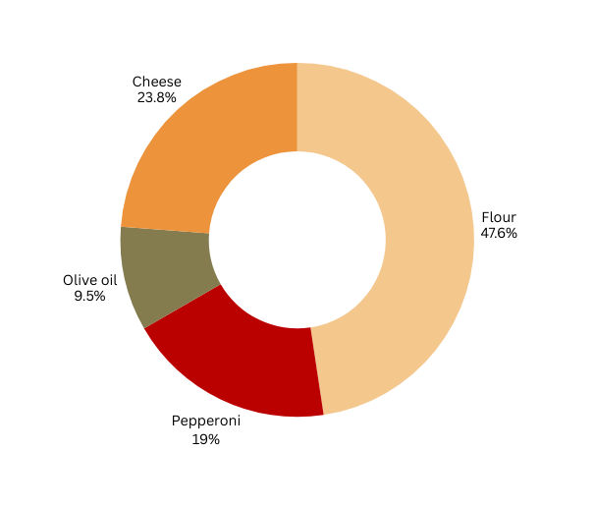
Welcome to Stock Pilot!
Dashboard
Low Stock Alert
items
Total Stock Value
Today’s Sale
$ 1,524
Order’s to Restock
items
Inventory
8
$35,540
3
Sales
Sales Overview
Inventory Status
Order history

Slide 5
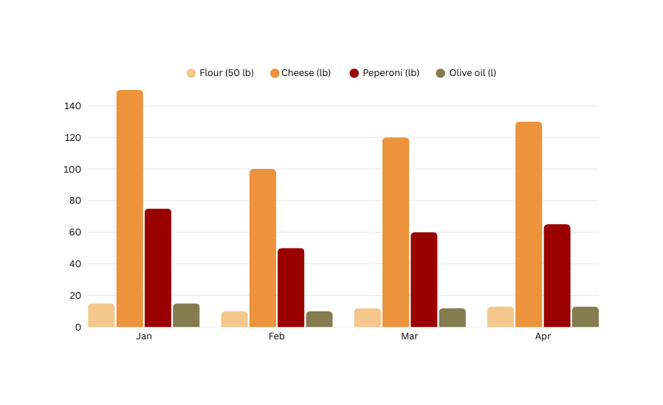

Inventory
Dashboard
Total Items
128
Low Stock Alert
alerts
Out of stock
items
Order’s to Deliver
orders
Inventory
2
3
6
Sales
Inventory usages by month
Items to Restock
Cheese (Mozerella)
Tomato sauce
Olive oil
Sausage
Basil
Flour
Order history

Slide 6
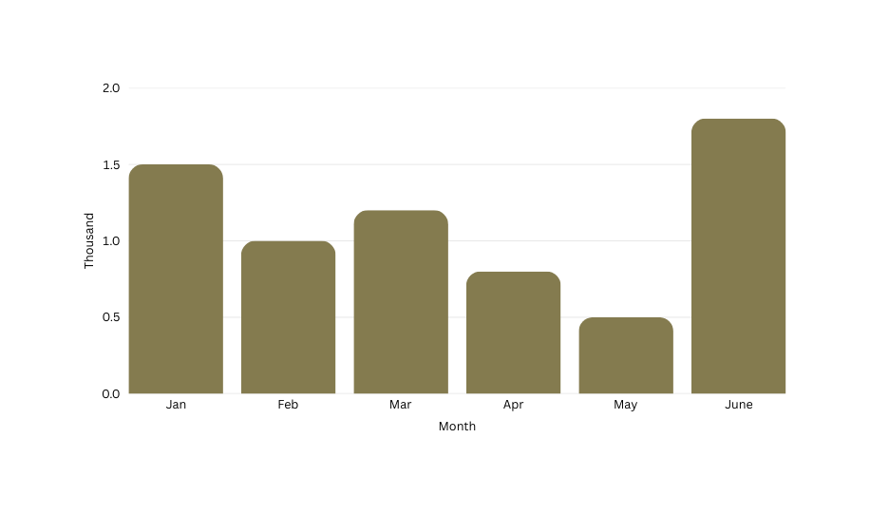

Sales
Dashboard
Total Revenue
$24,950
Total orders
orders
Top Selling Item
sold
Avg. Order Value
$36.69
Inventory
680
320
Sales
Sales Chart
Top Selling Products
Order history
Pepperoni Pizza
Meat Lover
Garlic Knots
King BBQ
Cheese Pizza
Bottle Coke

Slide 7
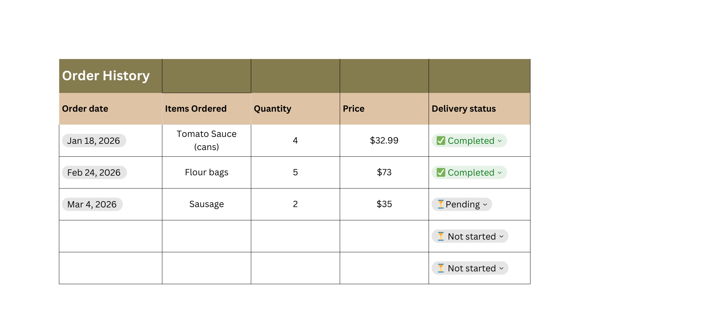
Order history
Dashboard
Order history
Inventory
Sales
Order history

Slide 8

Any Questions

